Slide 1
Ensemble Methods
Deepayan Chakrabarti (deepay@utexas.edu)

Slide 2
Ensemble Methods
The difficulties associated with building good classifiers can roughly be grouped as follows
Overfitting
If we have too many parameters, it is easy to overfit
E.g., very deep decision trees
Modeling assumptions
Each model makes some assumptions about the data
E.g., logistic regression assumes the existence of some unknown factor and the threshold

Slide 3
Ensemble Methods
Ensemble methods = combine multiple classifiers
Might be better able to avoid modeling biases
However, we must again be careful about overfitting
We will focus on ensembles of decision trees

Slide 4
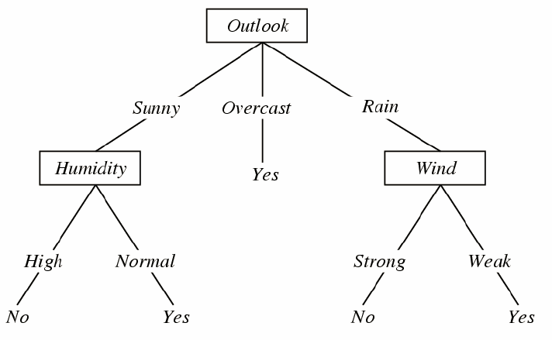
Reminder: Decision Tree
Decision trees are built by:
adding feature splits
one at a time
Then they are pruned
remove subtrees which do not help much
reduce tree height
This can overfit on complex datasets
Idea: Average many different models
The PlayTennis Decision Tree

Slide 5
Outline
Bagging
Random Forests
Boosting

Slide 6
Bagging
Fitting one deep decision tree may overfit
What if we fit many decision trees, and average?
Training
Create many approximate “copies” of the data
Copies are similar to the real dataset
but not identical
Fit a deep decision tree to each copy ➔ decision tree ensemble
Testing
Get predictions of all trees
Pick majority class

Slide 7
Bagging
How do we create “approximate copies”?
Bootstrap
Randomly pick one training data point
Save a copy
Repeat until you have as many points in the copy as in the training set
X₁ y₁
X₂ y₂
X₃ y₃
X₄ y₄
X₅ y₅
Actual training data
X₃ y₃
X₂ y₂
X₅ y₅
X₃ y₃
X₂ y₂
Bootstrapped copy

Slide 8
Bagging
How do we create “approximate copies”?
Bootstrap
Randomly pick training data points
with replacement
so the copy can have repeated points
Train a decision tree classifier on each such bootstrapped copy
X₁ y₁
X₂ y₂
X₃ y₃
X₄ y₄
X₅ y₅
X₃ y₃
X₂ y₂
X₅ y₅
X₃ y₃
X₂ y₂

Slide 9
Bagging
Advantage
Reduces variance of the final classifier
Decision trees are very sensitive to the precise training data points
By training on multiple bootstrapped copies, bagging reduces this uncertainty.
Disadvantage
If one or two features seem quite informative, each tree uses them for its first splits
Even though we learn multiple trees,
they can be too correlated

Slide 10
Outline
Bagging
Random Forests
Boosting

Slide 11
Random Forests
Popular refinement of bagging
Extends bagging by trying to “de-correlate” the trees
Each time we try to pick the best feature to split on,
we check only a random subset of the features
(instead of all features)
If there are some seemingly critical features
most trees in the ensemble will have it as the top splits
but some won’t
these trees learn “something different” from everyone else
might reduce overfitting

Slide 12
Outline
Bagging
Random Forests
Boosting

Slide 13
Boosting
Deep trees overfit
Shallow trees don’t
But shallow trees cannot represent complex patterns
Deep trees can
Can we get the benefits of both?
Combine shallow trees in an ensemble
(like bagging, sort of)
but give each tree a different weight
(unlike bagging’s majority vote)

Slide 14
Boosting
Start with one shallow decision tree
Fit to the training data
Make predictions on training data
For each training data point
Prediction = probability of positive versus negative class
Residual = difference between actual class (0 or 1) and prediction
Add second shallow tree, with some weight w₂
Prediction = prediction(first tree) + w₂ * prediction(second tree)
Re-calculate Residual
Add third tree, with weight w₃
Prediction = pred(tree 1) + w₂ * pred(tree 2) + w₃ * pred(tree 3)
Re-calculate Residual

Slide 15
Boosting
Start with one shallow decision tree
Fit to the training data
Add new trees with different weights
Goal: Minimize the residual in each step
New trees fix the errors made by previous ones
Their weights are optimized to reduce the residual
End result
Sequence of trees with weights
For any test point
Prediction = pred(tree 1) + w₂ * pred(tree 2) + w₃ * pred(tree 3) + …

Slide 16
Summary
Ensemble methods combine multiple classifiers
Bagging
Create equivalent training datasets
Train on each dataset
Majority vote for predictions
Random Forest
Like Bagging
but also use only a random subset of features for each split
Boosting
Uses shallow trees ➔ less overfitting
Learns different weights for each tree

Slide 17
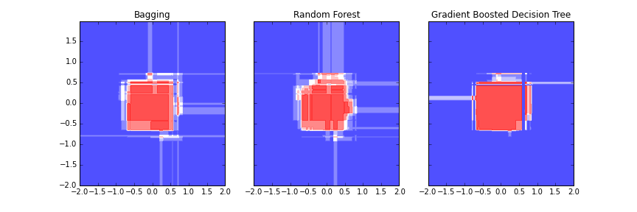
Boosting

Slide 18
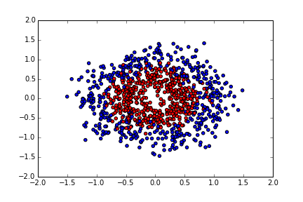
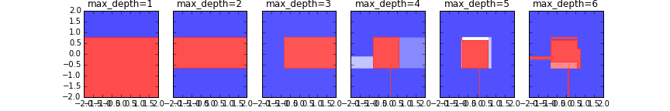
Reminder: Decision Trees
Two classes: red and blue
Two features: x and y
Decision tree predictions for different tree depths
Notes:
For example, features are “height” and “muscle-mass”. Red=tennis player, Blue=not good tennis player.

Slide 19
Reminder: Decision Trees
As the tree tries to match the circular pattern better
it becomes ever more complex
may overfit
Idea: Average many different models

Slide 20
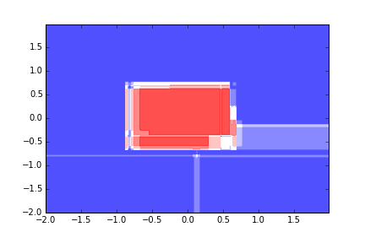
Bagging

Slide 21
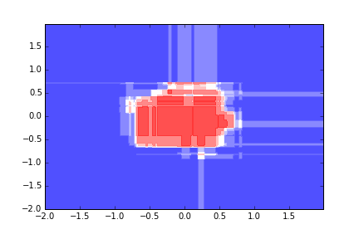
Random Forests
Bagging
Bagging and random forest are similar here, since there is no dominant feature
Random Forest

